Slide 1

Transforming Risk Aggregation: The DataConnect Initiative
In an increasingly complex and interconnected business landscape, effective risk management is paramount. Our current manual processes for risk aggregation, while functional, are no longer sufficient to meet the demands of rapid decision-making and comprehensive oversight. This presentation outlines the DataConnect program, a strategic initiative designed to automate risk aggregation, enhance data quality, and revolutionize our risk reporting capabilities through the powerful RiskOne platform.

Slide 2
Agenda: A Strategic Roadmap to Enhanced Risk Management
01
02
03
The Challenge
Introducing DataConnect
Revolutionizing Risk Reporting
Understanding the limitations of our current manual risk aggregation processes.
A deep dive into the architecture and core functionalities of our in-house built automation solution.
Leveraging the RiskOne platform for comprehensive and intuitive risk intelligence.
04
05
Key Benefits
2024 Roadmap & Beyond
Quantifying the impact on data quality, data lineage, and operational efficiency.
Strategic priorities and future vision for enterprise-wide risk management.

Slide 3

The Imperative for Automation: Overcoming Manual Limitations
Current State: Manual Risk Aggregation
Our existing processes rely heavily on manual data collection, consolidation, and analysis. While diligent, this approach is inherently prone to several challenges:
Time-consuming and resource-intensive, diverting valuable personnel from strategic tasks.
Increased risk of human error in data entry and aggregation, impacting report accuracy.
Lack of real-time visibility into emerging risks, hindering agile response.
Difficulty in maintaining consistent data quality and ensuring end-to-end data lineage.
Limited scalability as the volume and complexity of risk data continue to grow.
"The speed of risk evolution demands a proportional acceleration in our ability to aggregate and analyze it."
This manual burden not only impedes efficiency but also introduces critical blind spots, making proactive risk management a formidable challenge. The DataConnect program directly addresses these pain points by introducing robust automation and a centralized reporting framework.

Slide 4

Introducing DataConnect: Our Automated Risk Aggregation Engine
DataConnect is an in-house developed solution designed to seamlessly automate the aggregation of risk data from disparate sources, laying the foundation for intelligent risk reporting.
Key Features of DataConnect:
Fundamental Principles:
Automated Data Ingestion: Connects directly to various risk data sources, pulling information automatically and eliminating manual entry.
Implicit Data Quality: DataConnect is engineered with embedded quality controls. This means data is validated and cleaned as it moves through the system, dramatically reducing errors upstream and ensuring the accuracy of downstream reports.
Data Standardization: Transforms raw data into a consistent format, ensuring uniformity across all risk domains.
Intelligent Validation: Implements automated checks to identify and flag data anomalies or inconsistencies at the point of ingestion.
Automated Data Lineage: From source to report, DataConnect automatically tracks the origin and transformation of every data point. This provides unparalleled transparency and traceability, crucial for regulatory compliance and deep-dive analysis.
Robust Audit Trails: Maintains a comprehensive log of all data transformations and movements, ensuring transparency.
Beyond Automation: DataConnect doesn't just automate; it enhances the reliability and integrity of our risk data, creating a single source of truth.

Slide 5
RiskOne Platform: The Future of Enterprise Risk Reporting
RiskOne is our centralized, cutting-edge platform designed to consume the high-quality, aggregated data from DataConnect and transform it into actionable risk intelligence.
1
2
Comprehensive View
Customizable Dashboards
Provides a consolidated, real-time overview of enterprise-wide risk exposures.
Enables senior executives to tailor views and focus on specific risk categories or metrics relevant to their oversight responsibilities.
3
4
Advanced Analytics
Drill-Down Capabilities
Leverages robust analytical capabilities to identify trends, predict potential risks, and inform strategic decision-making.
Allows users to delve deeper into specific risk areas, accessing granular data for comprehensive understanding and investigation.
The integration of DataConnect with RiskOne creates a powerful synergy, ensuring that our risk reporting is not only efficient but also insightful, reliable, and tailored to the needs of senior leadership.

Slide 6
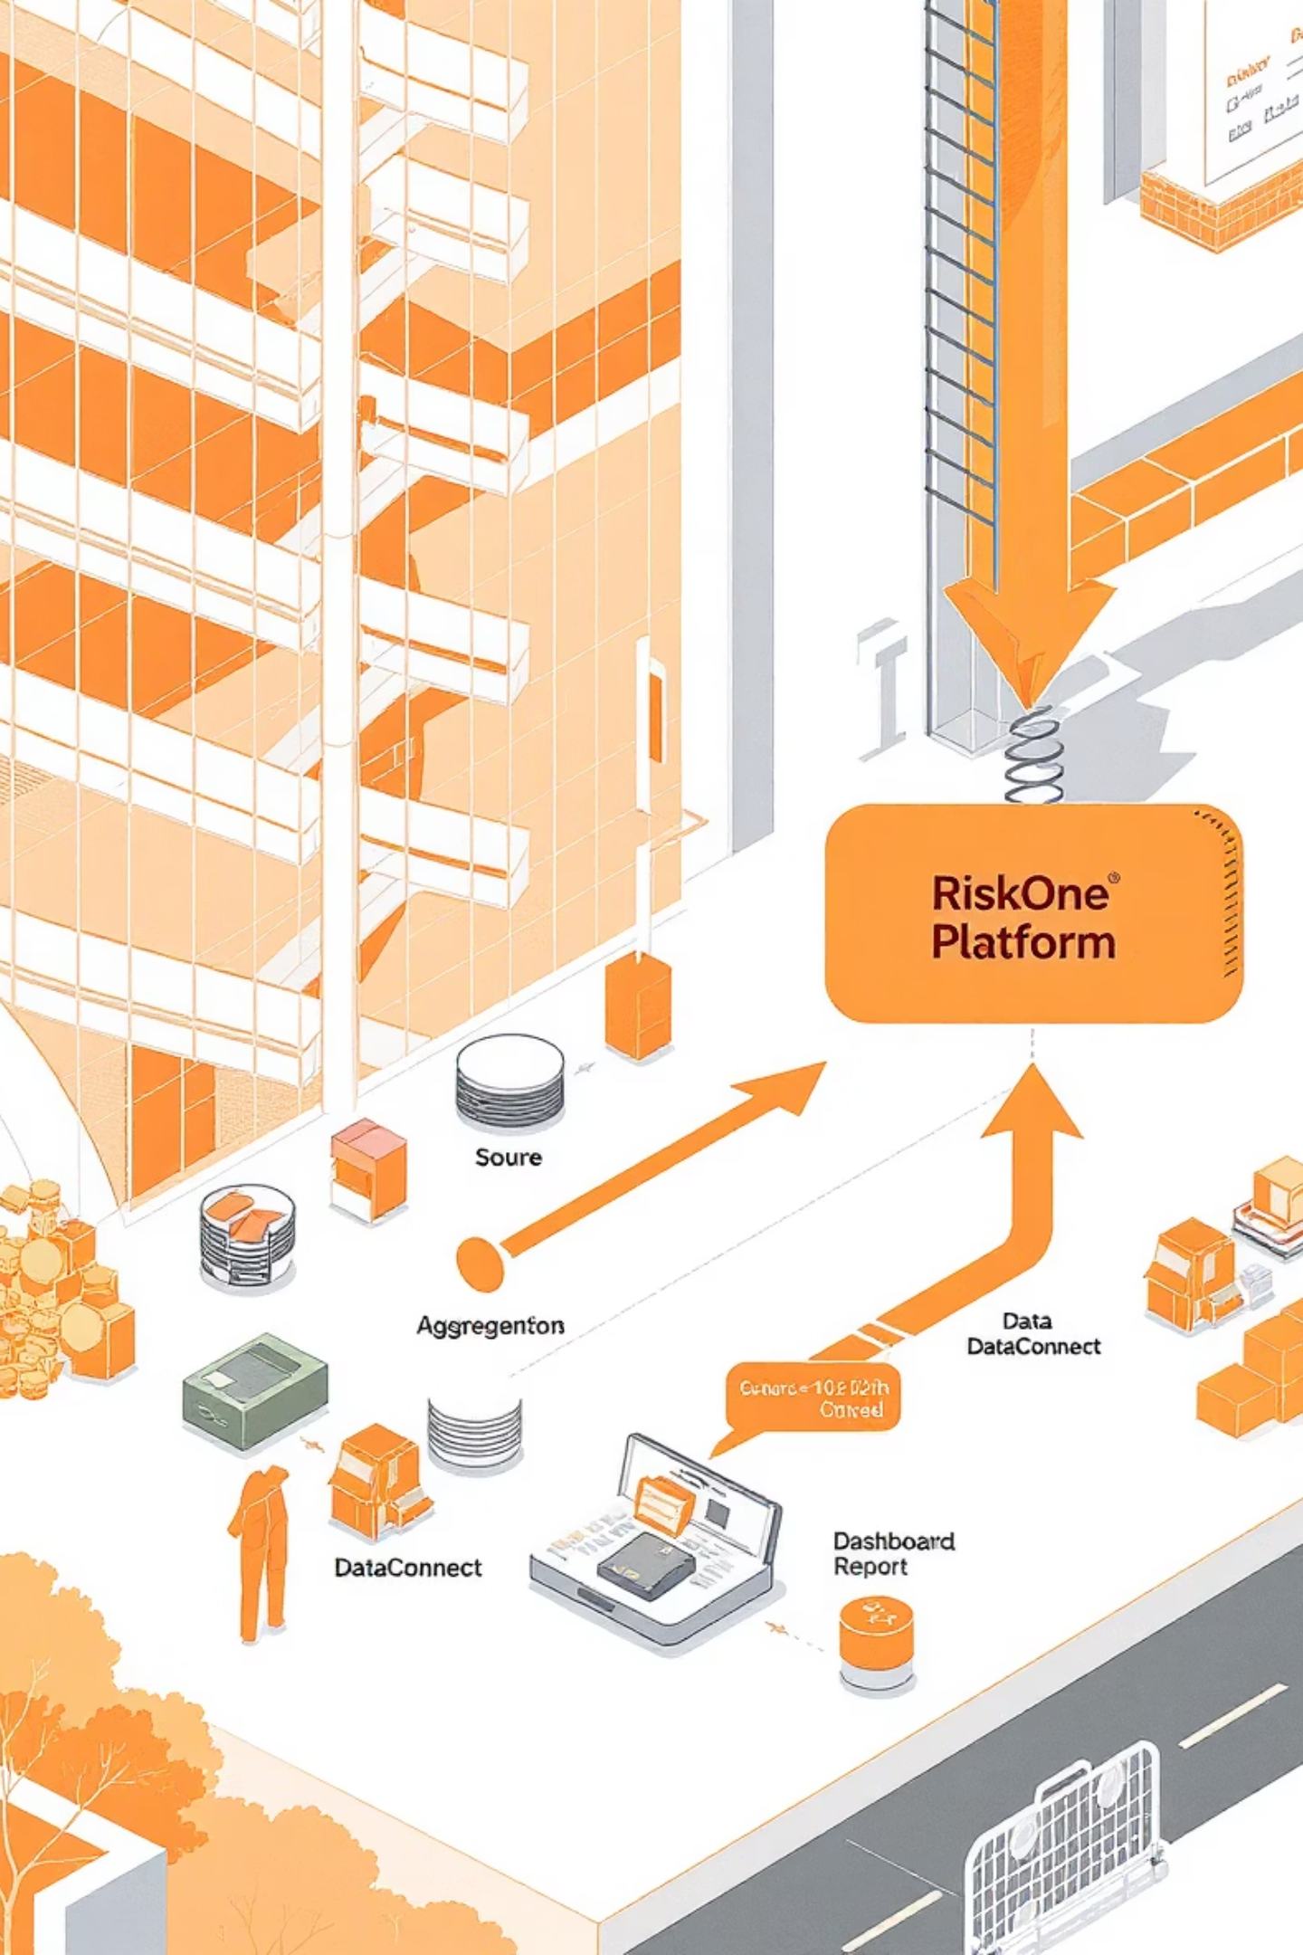
Strategic Synergy: DataConnect to RiskOne Ecosystem
This diagram illustrates the integrated architecture of our transformed risk aggregation and reporting ecosystem, highlighting the critical role of DataConnect as the backbone for RiskOne.
Source Systems ➔ DataConnect (Aggregation & Quality) ➔ RiskOne Platform (Reporting & Analytics)
This phased approach ensures that as data flows from its disparate origins through DataConnect, it is automatically cleansed, validated, and enriched, guaranteeing that only high-integrity data populates the RiskOne platform. This seamless, automated flow empowers us to move from reactive data reconciliation to proactive risk intelligence.

Slide 7

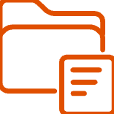
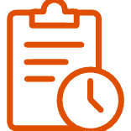


Key Benefits: Driving Value Across the Enterprise
Accelerated Reporting
Enhanced Data Quality
Reduces the time spent on data collection and aggregation by up to 70%, enabling faster report generation and decision-making cycles.
Automated validation and standardization within DataConnect significantly reduce manual errors, leading to higher confidence in our risk data.
Transparent Data Lineage
Operational Efficiency
Full traceability from source to report ensures auditability and deep understanding of data transformations, meeting regulatory scrutiny.
Frees up valuable resources from repetitive tasks, allowing teams to focus on strategic analysis and proactive risk mitigation.
Improved Decision-Making
Scalability & Agility
Access to timely, accurate, and comprehensive risk intelligence empowers senior leadership to make more informed and agile strategic decisions.
The automated framework can easily scale to accommodate growing data volumes and evolving risk reporting requirements without significant manual overhead.

Slide 8
2024 Roadmap: Focused Execution for Immediate Impact
This year, our primary focus is on demonstrating tangible value by delivering critical risk reports through the new RiskOne platform, powered by DataConnect.
Q1
DataConnect Core Development & Integration with Key Risk System A
System architecture finalized, initial data feeds established. On Track.
Q2
Launch of Report 1: Operational Risk Overview
First critical report migrated to RiskOne, providing automated insights into operational incidents. Completed.
Q3
Launch of Report 2: Compliance Risk Exposure
Automated reporting for regulatory compliance metrics and potential breaches. In Progress.
Q4
Launch of Report 3 & 4: Emerging Risk Landscape & Financial Impact Analysis
Comprehensive views on forward-looking risks and their potential financial implications. Planned.
By the end of 2024, all foundational risk reporting will be channeled through the RiskOne platform, leveraging the robust capabilities of DataConnect. This ensures a unified, accurate, and efficient risk intelligence framework.

Slide 9
Looking Ahead: The Vision for Integrated Risk Management
Our journey with DataConnect and RiskOne extends beyond 2024. The foundation laid this year will enable a future of truly integrated and predictive risk management.
Phase 2: Predictive Analytics & Scenario Modeling
Phase 3: AI-Powered Risk Intelligence
Leveraging the rich, high-quality data to build advanced predictive models and conduct complex scenario analysis, allowing for proactive risk mitigation.
Integrating artificial intelligence and machine learning to identify subtle patterns, anomalies, and emerging risks that human analysis might miss.
Enterprise-Wide Integration
Continuous Improvement
Expanding DataConnect's reach to encompass all enterprise data sources relevant to risk, creating a holistic view across business units.
Establishing a feedback loop with risk leaders to continuously refine and enhance the capabilities of DataConnect and RiskOne based on evolving business needs and regulatory landscapes.
This vision positions us at the forefront of risk management, transforming it from a compliance-driven function to a strategic enabler of business growth and resilience.

Slide 10

Key Takeaways & Next Steps
Key Takeaways:
Next Steps:
Automation is Key: DataConnect automates manual risk aggregation, enhancing efficiency and accuracy.
Executive Steering Committee Meeting: Review progress and provide strategic guidance on Q3 and Q4 deliverables. (September 15th)
Data Quality by Design: Implicit data quality and lineage are core advantages of the DataConnect architecture.
RiskOne is the Future: All risk reporting will consolidate onto the powerful, intuitive RiskOne platform.
Deep Dive Workshops: Schedule specific sessions with risk domain leaders to gather feedback and refine future reporting requirements for 2025 planning.
Tangible Value Delivered: Four critical reports will be live on RiskOne this year, demonstrating immediate benefits.
User Training & Adoption: Plan comprehensive training for all risk teams to ensure seamless transition and maximum utilization of RiskOne capabilities.
Strategic Evolution: This program sets the stage for advanced analytics and predictive risk management.
Future Planning: Initiate discussions for the 2025 roadmap, focusing on expanding DataConnect integrations and advanced analytics features.

